Slide 1
Dynamic Programming
8 -<number>

Slide 2
Dynamic Programming
Dynamic Programming is an algorithm design method that can be used when the solution to a problem may be viewed as the result of a sequence of decisions
8 -<number>

Slide 3
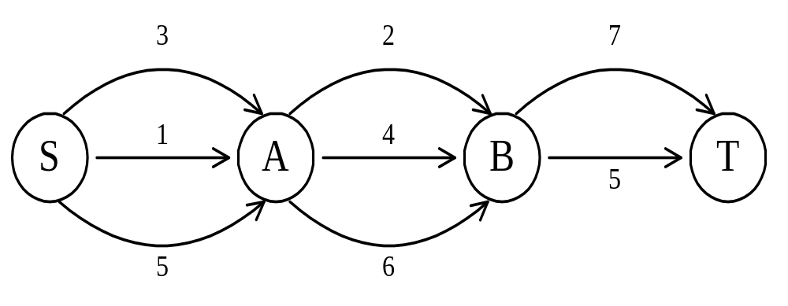
The shortest path
To find a shortest path in a multi-stage graph
Apply the greedy method :
the shortest path from S to T :
1 + 2 + 5 = 8
8 -<number>

Slide 4
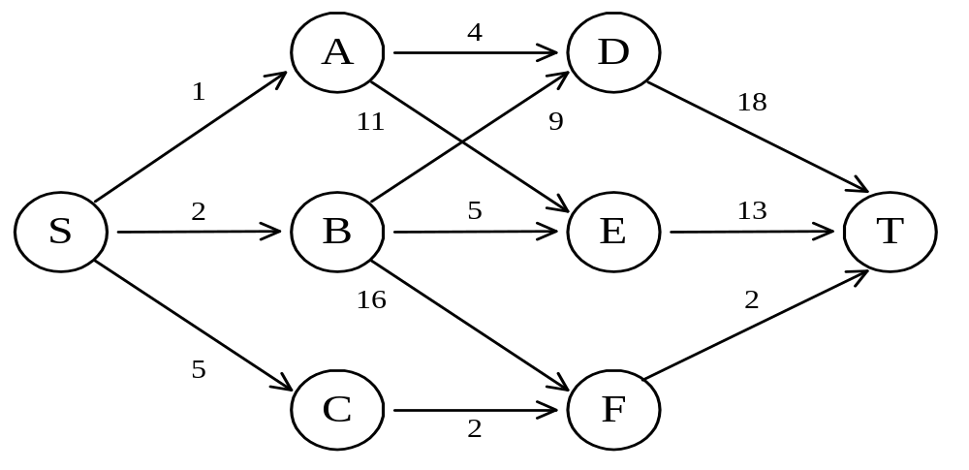
The shortest path in multistage graphs
e.g.
The greedy method can not be applied to this case: (S, A, D, T) 1+4+18 = 23.
The real shortest path is:
(S, C, F, T) 5+2+2 = 9.
8 -<number>

Slide 5
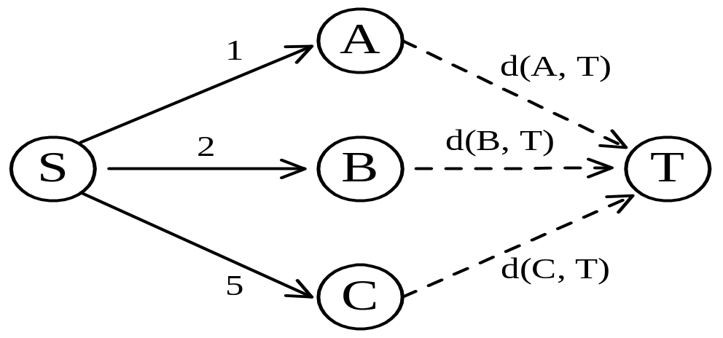
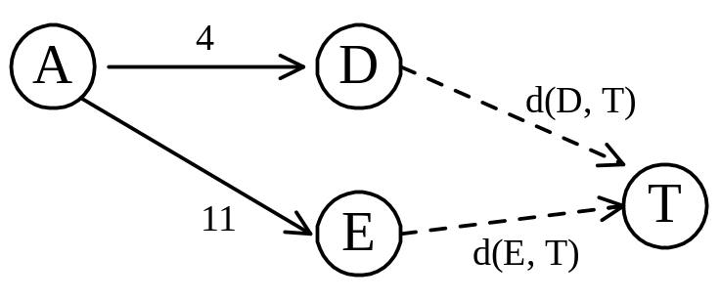
Dynamic programming approach
Dynamic programming approach (forward approach):
d(S, T) = min{1+d(A, T), 2+d(B, T), 5+d(C, T)}
d(A,T) = min{4+d(D,T), 11+d(E,T)}
= min{4+18, 11+13} = 22.
8 -<number>

Slide 6
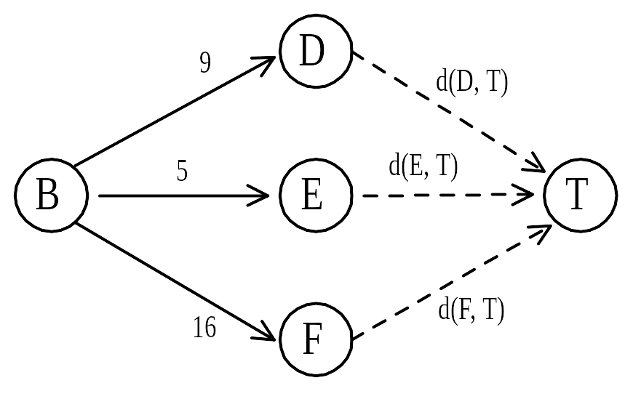
Dynamic programming
d(B, T) = min{9+d(D, T), 5+d(E, T), 16+d(F, T)}
= min{9+18, 5+13, 16+2} = 18.
d(C, T) = min{ 2+d(F, T) } = 2+2 = 4
d(S, T) = min{1+d(A, T), 2+d(B, T), 5+d(C, T)}
= min{1+22, 2+18, 5+4} = 9.
The above way of reasoning is called
backward reasoning.
8 -<number>

Slide 7
Backward approach
(forward reasoning)
d(S, A) = 1
d(S, B) = 2
d(S, C) = 5
d(S,D)=min{d(S, A)+d(A, D),d(S, B)+d(B, D)}
= min{ 1+4, 2+9 } = 5
d(S,E)=min{d(S, A)+d(A, E),d(S, B)+d(B, E)}
= min{ 1+11, 2+5 } = 7
d(S,F)=min{d(S, A)+d(A, F),d(S, B)+d(B, F)}
= min{ 2+16, 5+2 } = 7
8 -<number>

Slide 8
d(S,T) = min{d(S, D)+d(D, T),d(S,E)+
d(E,T), d(S, F)+d(F, T)}
= min{ 5+18, 7+13, 7+2 }
= 9
8 -<number>

Slide 9
Principle of optimality
Principle of optimality: Suppose that in solving a problem, we have to make a sequence of decisions D₁, D₂, …, D_{n}. If this sequence is optimal, then the last k decisions, 1 < k < n must be optimal.
e.g. the shortest path problem
If i, i₁, i₂, …, j is a shortest path from i to j, then i₁, i₂, …, j must be a shortest path from i₁ to j
In summary, if a problem can be described by a multistage graph, then it can be solved by dynamic programming.
8 -<number>

Slide 10
Dynamic programming
Forward approach and backward approach:
  Note that if the recurrence relations are formulated using the forward approach then the relations are solved backwards . i.e., beginning with the last decision
  On the other hand if the relations are formulated using the backward approach, they are solved forwards.
To solve a problem by using dynamic programming:
  Find out the recurrence relations.
  Represent the problem by a multistage graph.
8 -<number>

Slide 11
Multistage Graph
A multi stage graph G = (V,E) is a directed graph in which vertices are partitioned into K>=2 disjoint set where [1<=i<=k] in addition if (u,v) is an edge E then u€ v_{i}, v€v_{i+1}

Slide 12
Multistage graph problem
Let C(i,j) be the cost of edge (I,j).
  The cost of a path from S to T is the sum of the costs of the edges on the path.
  The multistage graph problem is to find the minimum cost from S to T
  The values on the edges are called cost of edges.

Slide 13
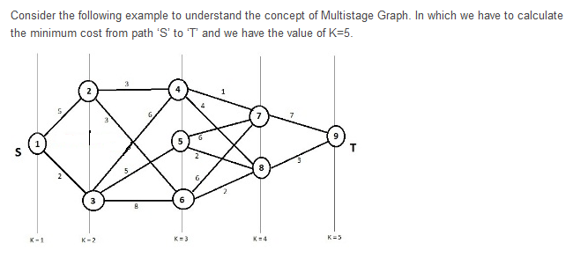

Example

Slide 14
Solution- Step -1
Use the formula to calculate the min cost(I,j).

Slide 15
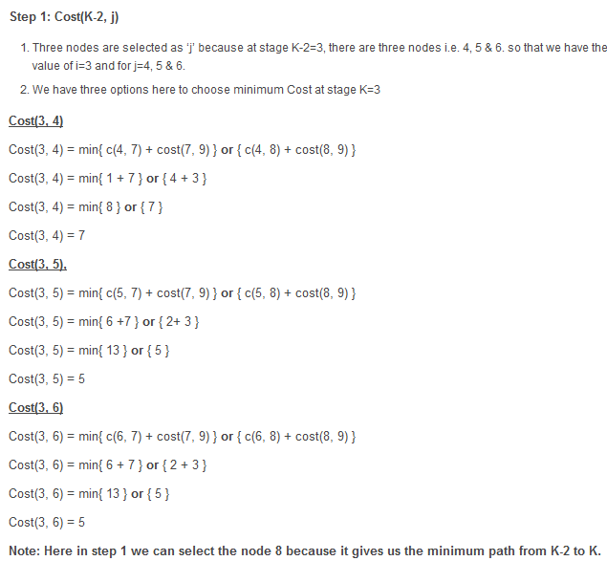

Slide 16
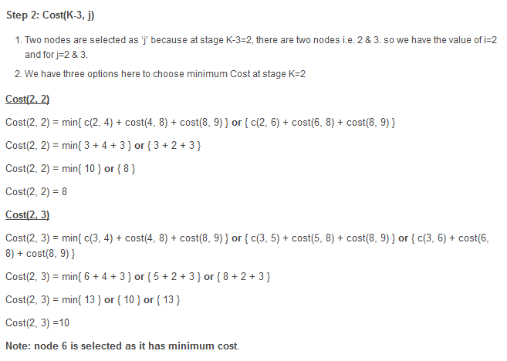

Slide 17
